Slide 1
Understanding REST and OpenAPI V3 (Swagger) The Gateway to Digital Transformation
Wim Jongman, CTO Remain Software

Slide 2
Agenda
A Definition of Digital Transformation
The Technology
Design a Rest Service

Slide 3

Digital Transformation

Slide 4
Digital Transformation
Digital Age, Digital Highway, Digital Marketplace
Your Digital Potential
What is your offering?

Slide 5
The Technology
The HTTP Protocol
OpenAPI Standards – OAS V3
Micro Services

Slide 6
The HTTP protocol
HTTP Verbs
CRUD vs PGPD
READ - GET
CREATE - POST
UPDATE - PUT
DELETE – DELETE
May be abused if you want
The standard of the internet

Slide 7
Get VS Post
POST may carry large amount of input
GET may not

Slide 8
Open API Specifications – OAS3
A standard way to describe services
Contract between client and server
Adopted by the internet

Slide 9
Open API Specifications – OAS3
General Information
Where to reach the service
How to call the service (GET/POST/Etc..)
What is the expected input
What is the expected output

Slide 10
Micro Services
Monolithic vs Modular
Application Server vs Micro Service

Slide 11
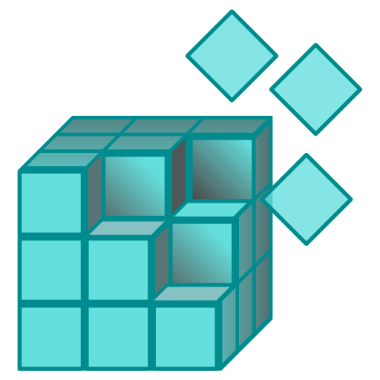
Micro Services
PGM1
PGM2
PGM3
PGMx

Slide 12
Micro Services
PGM1
PGM2
PGM3
PGMx
microservice

Slide 13
Micro Services
PGM1
PGM2
PGM3
PGMx
microservice

Slide 14
Demo
The case:
Business wants to make the customer list available through a REST service.
Design, Create, and Test the service.

Slide 15
Show Time
Getting OpenAPI Studio
Analysis and Design
Creating and Testing a Service
Generating Code
CGI – Pedal to the Metal
Defining a CGI Server

